Slide 1
Multi Threading

Slide 2
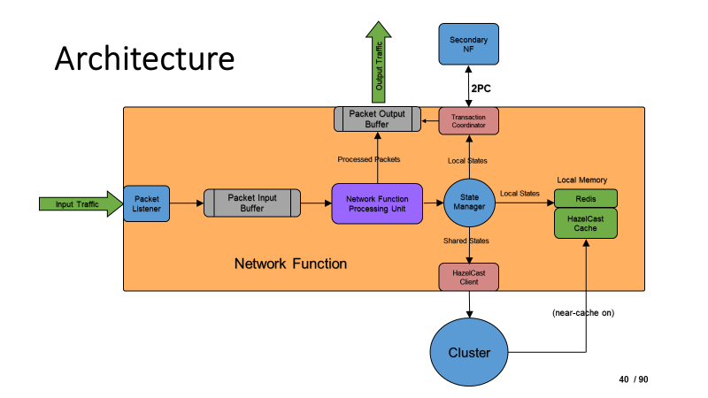
One instance for every thread

Slide 3
Identifying Thread ID
pkt(flowID,perflowCount)
determineThreadID(flowID)
Array of Link-list
(key,val) = (threadID,listOfFlowIDs)

Slide 4
Properties of multithreading
Variables: maxFlowCount, maxIdleTime
Multiple flows will be processed inside a single thread
After being idle for a fixed time, the thread will be destroyed and that corresponding threadID will be unoccupied
We will find the threadID using hash function.
If the capacity of that thread is full, we will select the next theadID and will do this circularly until finding a threadID.
If all threads’ capacity exceeds, then select the thread with highest idle time and discard all the flows and start it with the new flow.

Slide 5
Inside a Thread
Integer
idleTime/ lastActiveTime
flowCount
Hashmaps
nextExpectedPktID (key: flowID val: nextPerFlowCount)
pendingList (key: flowID val: priority queue of not processed pkt with higher perflowcounter)

Slide 6
Some Confusions
What about input or output buffers?

